Slide 1
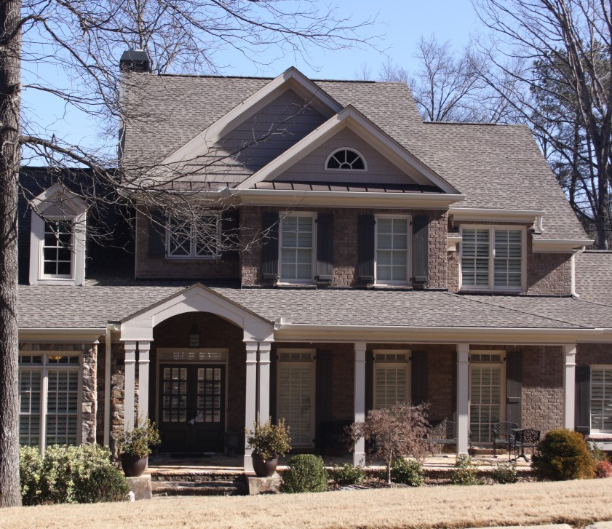
Machine learning model

Slide 2
The correlations between the numerical features and the target (price).
price sqft_living sqft_above sqft_living15 bathrooms sqft_basement bedrooms lat floors sqft_lot sqft_lot15 long month | 1.000000 0.701917 0.605368 0.585241 0.525906 0.323799 0.308787 0.306692 0.256804 0.089876 0.082845 0.022036 -0.009928

Slide 3
From this table, we can see that features like sqft_living, sqft_above, and bathrooms have relatively high positive correlations with price, suggesting they are important predictors for determining house prices. In contrast, features like sqft_lot and month have minimal correlations, indicating they may have little influence on the pricing model.

Slide 4
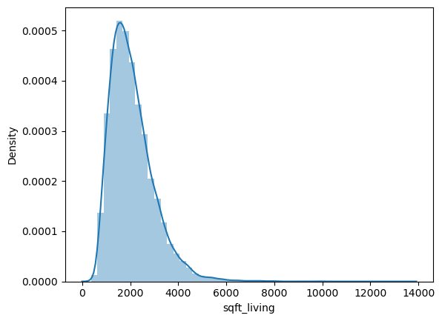
Positively skewed distribution (outliers at the left end).

Slide 5
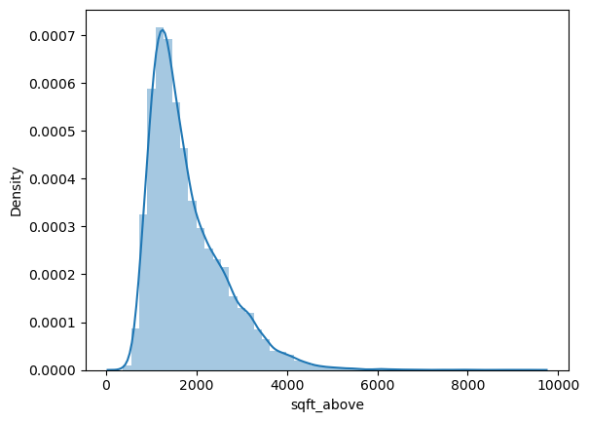
Positively skewed distribution (outliers at the left end).

Slide 6
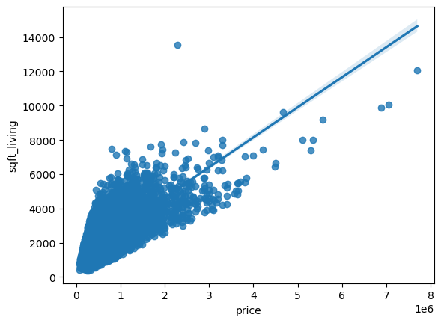
sqft_living has the highest correlation, we can see it in a plot:

Slide 7
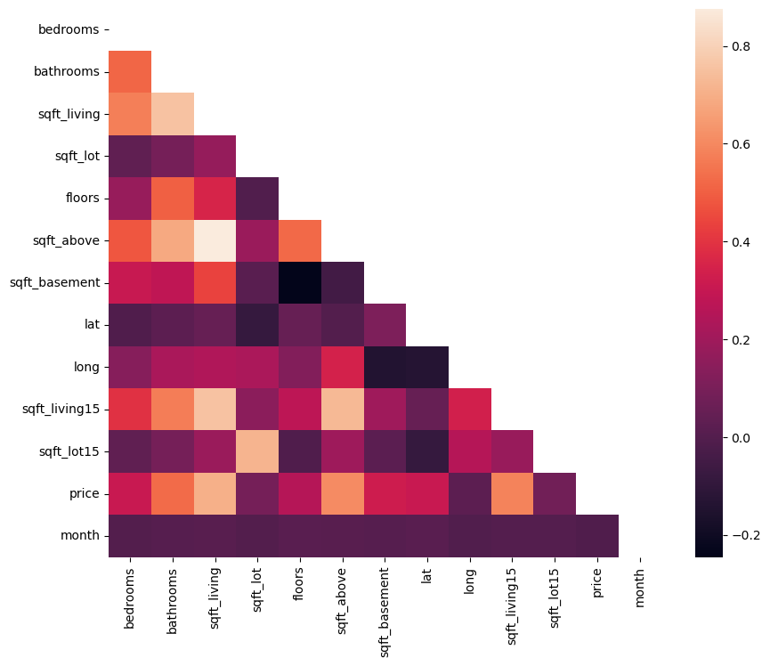
Heatmap

Slide 8
Initially, I trained the model on the unscaled training data, and the results were as follows:
R2_score 0.68
RMSE: 204629.49658529108
MAE: 126393.74297919509
In the second step, I retrained the model using scaled data (for both features and targets), and as you can see, the R² score improved.
R2_score: 0.76

Slide 9
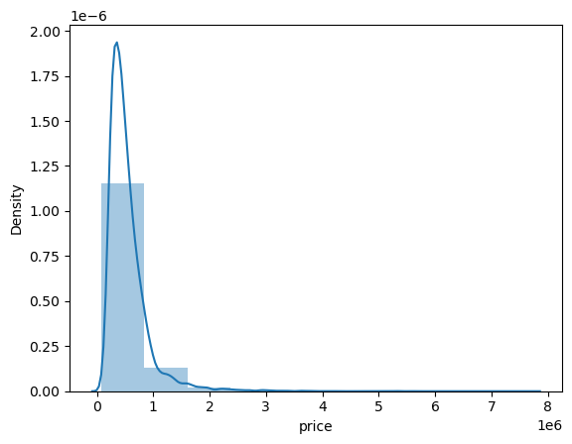
We can see how log scaling changed the distribution: 1. Before scaling:

Slide 10
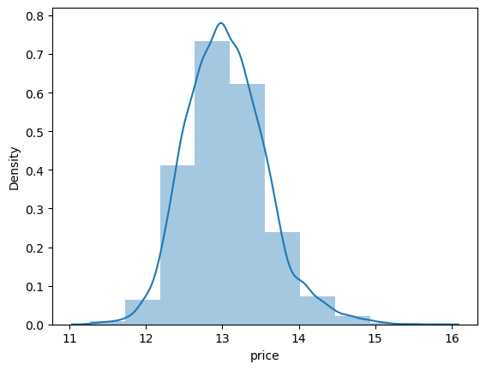
After scaling:

Slide 11
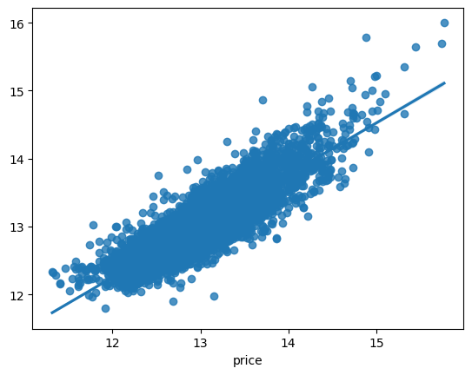
We can observe that the points are tightly grouped around the regression line, which suggests strong predictive performance.

Slide 12
In the second step, I retrained the model using scaled data (for both features and targets), and as you can see, the R2_ score improved.
R2_score: 0.76

Slide 13
In the next step, I trained the model again, but without the outliers.
R2_score decreased from 0.76 to 0.72
RMSE: 116752.98533421374
MAE: 85972.8827036397
The reduction in both RMSE and MAE indicates that the model's predictions have become more accurate after scaling the data. This significant drop suggests that the model is now making predictions that are closer to the actual target values.

Slide 14
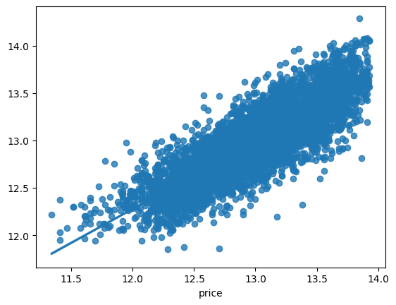
We can see that the points are closely clustered around the regression line, indicating robust predictive performance

Slide 15
Cross-Validation. I used also cross-validation techniques. It returned the following results:
Cross-Validation R2_Scores: [0.72089692 0.70620755 0.72362666 0.71845411 0.70688766]
Mean R2_Score: 0.72

